Slide 1
Title
Author(s)
Affiliations of author(s)
9:16 ratio of Digital Poster Portrait Template
This template has been designed to show clearly within the digital poster screen and app that will be used for the Conference.
Please clear all text and objects on this template before designing your poster.
Your poster should include the following sections: Introduction, Materials & Methods, Results, and Conclusion.
We recommend you use standard system fonts such as Calibri, Verdana, Times New Roman, or Arial.
Recommended font sizes:
48-60pt for Titles/Headings
24-30pt for Text
You are limited to 1 slide within your digital poster.
Format should be submitted in PDF only.

Slide 2
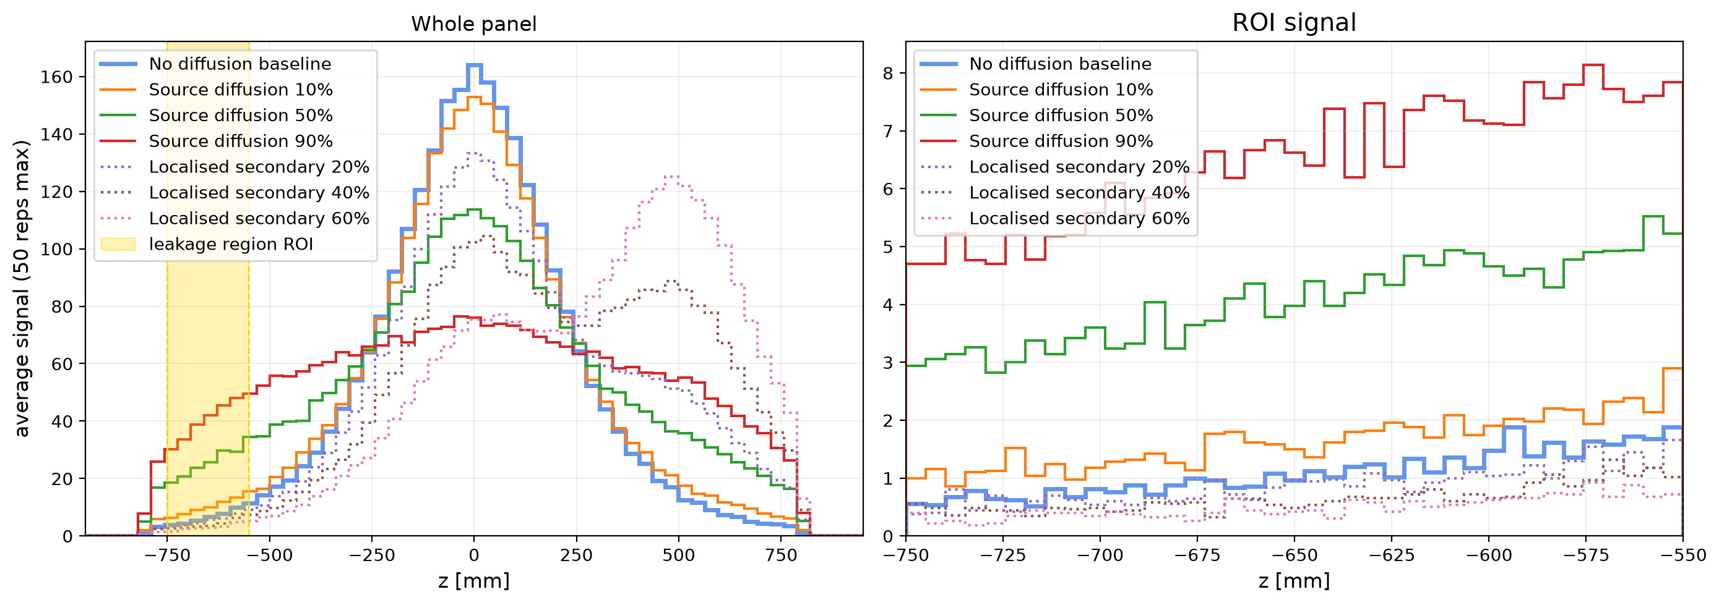
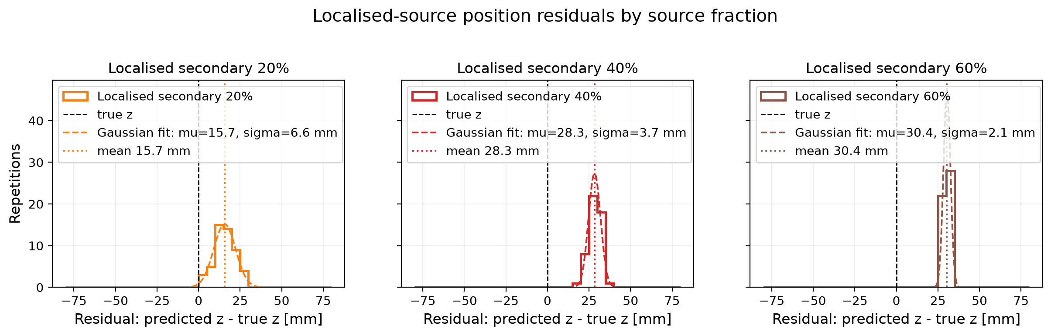
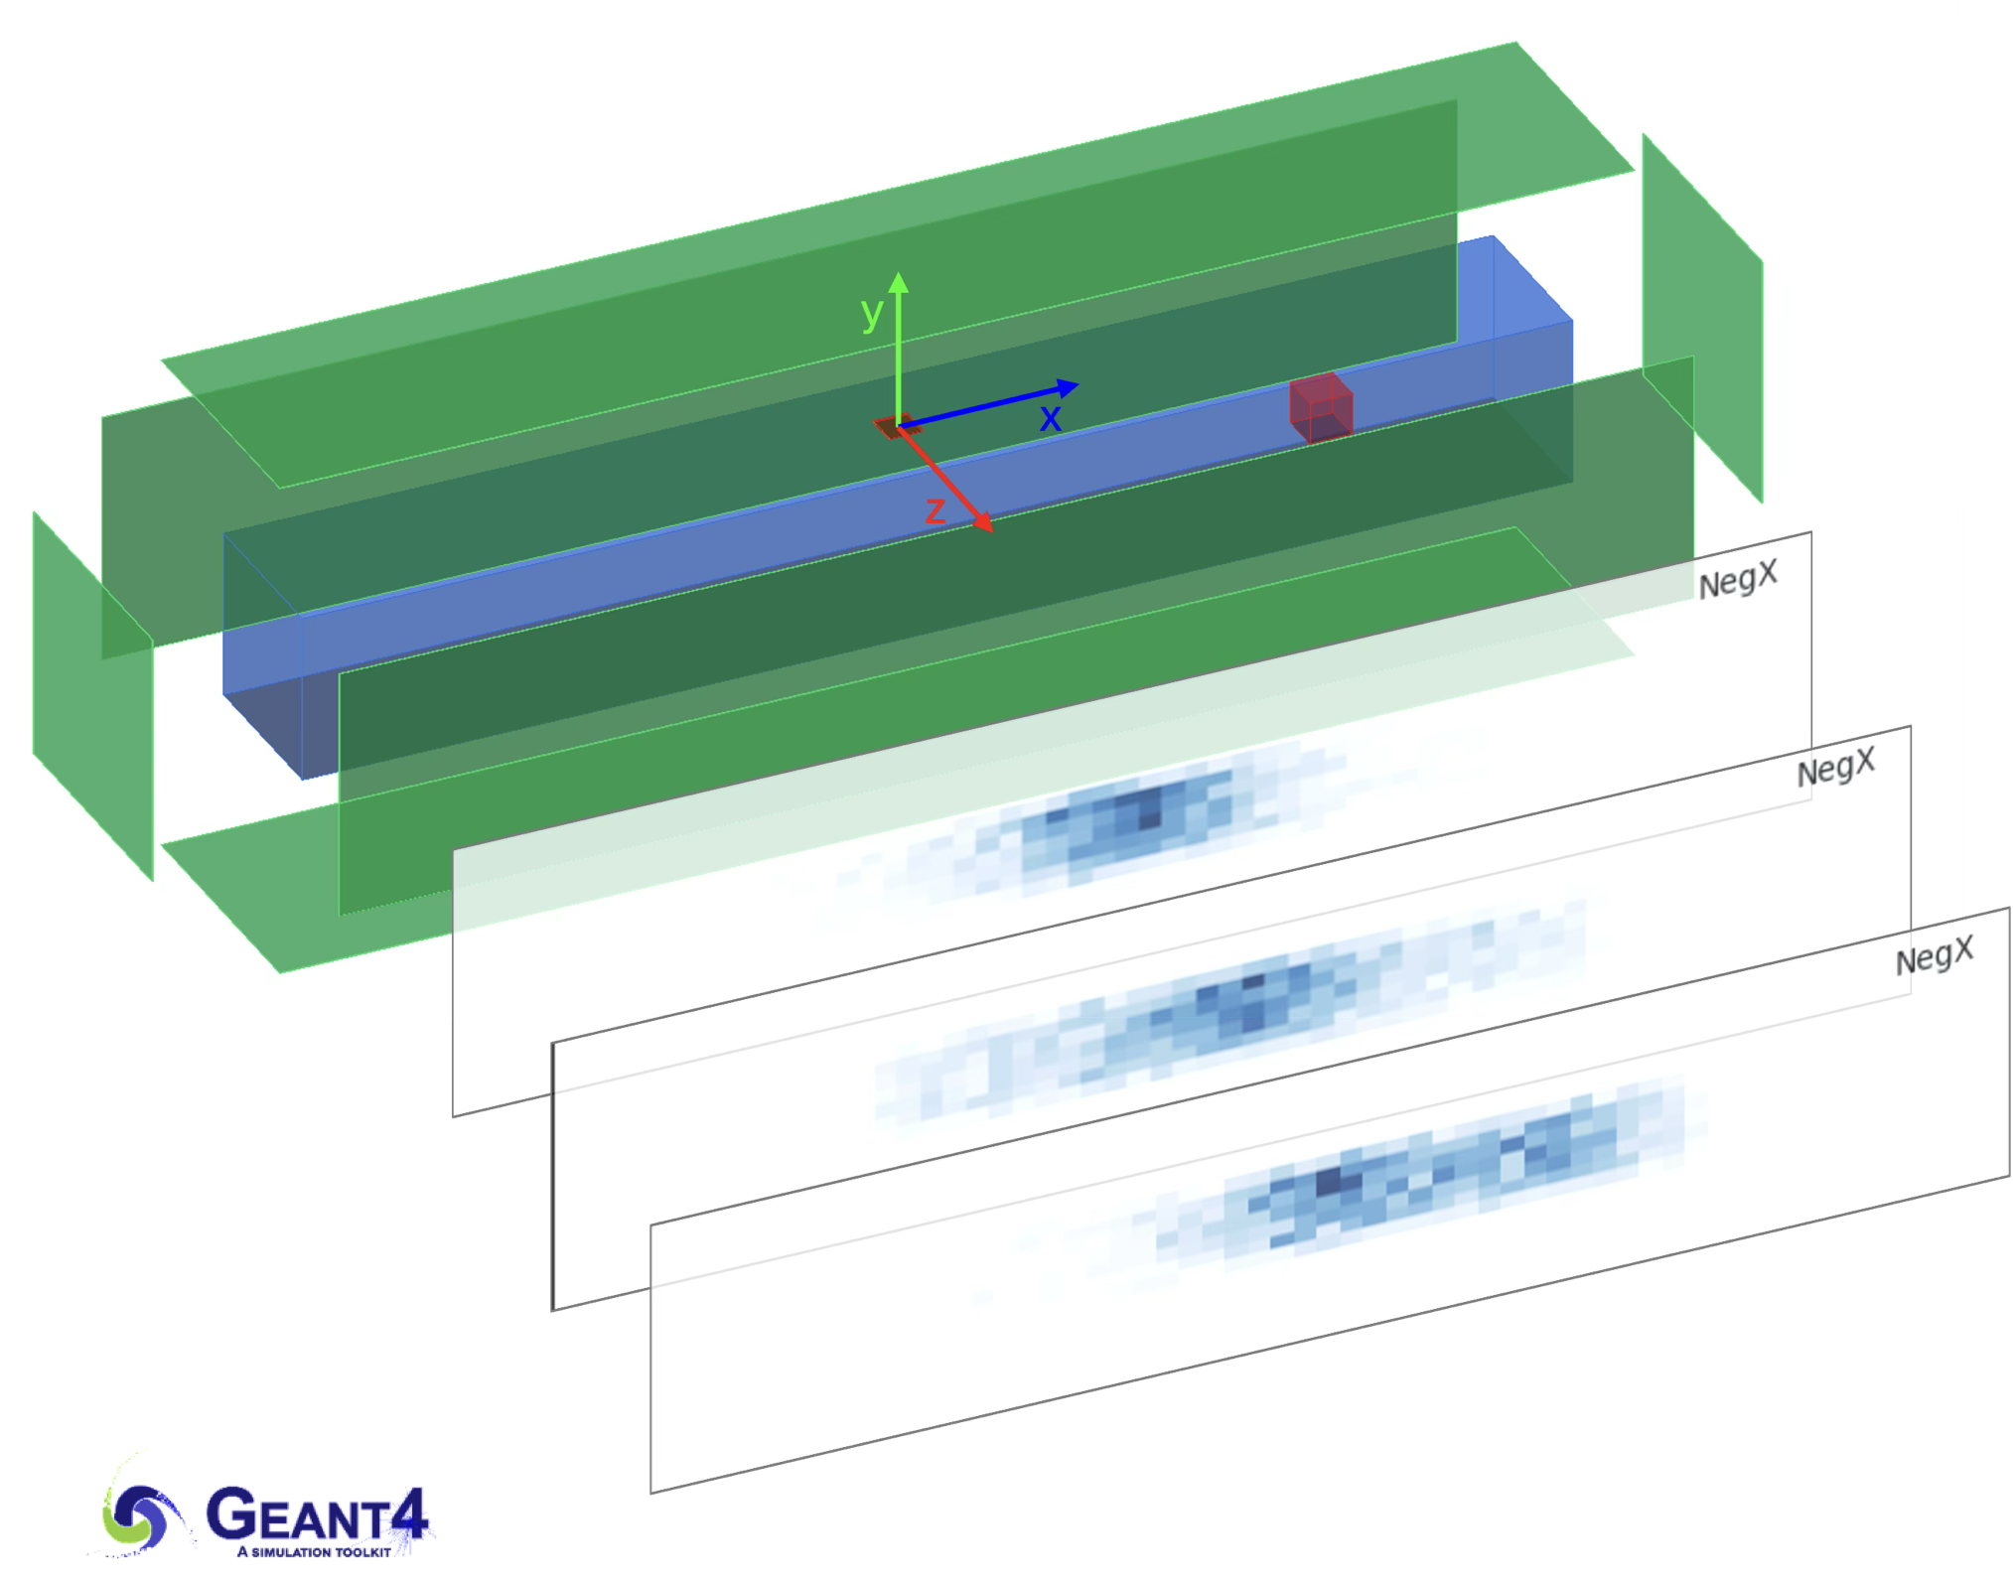
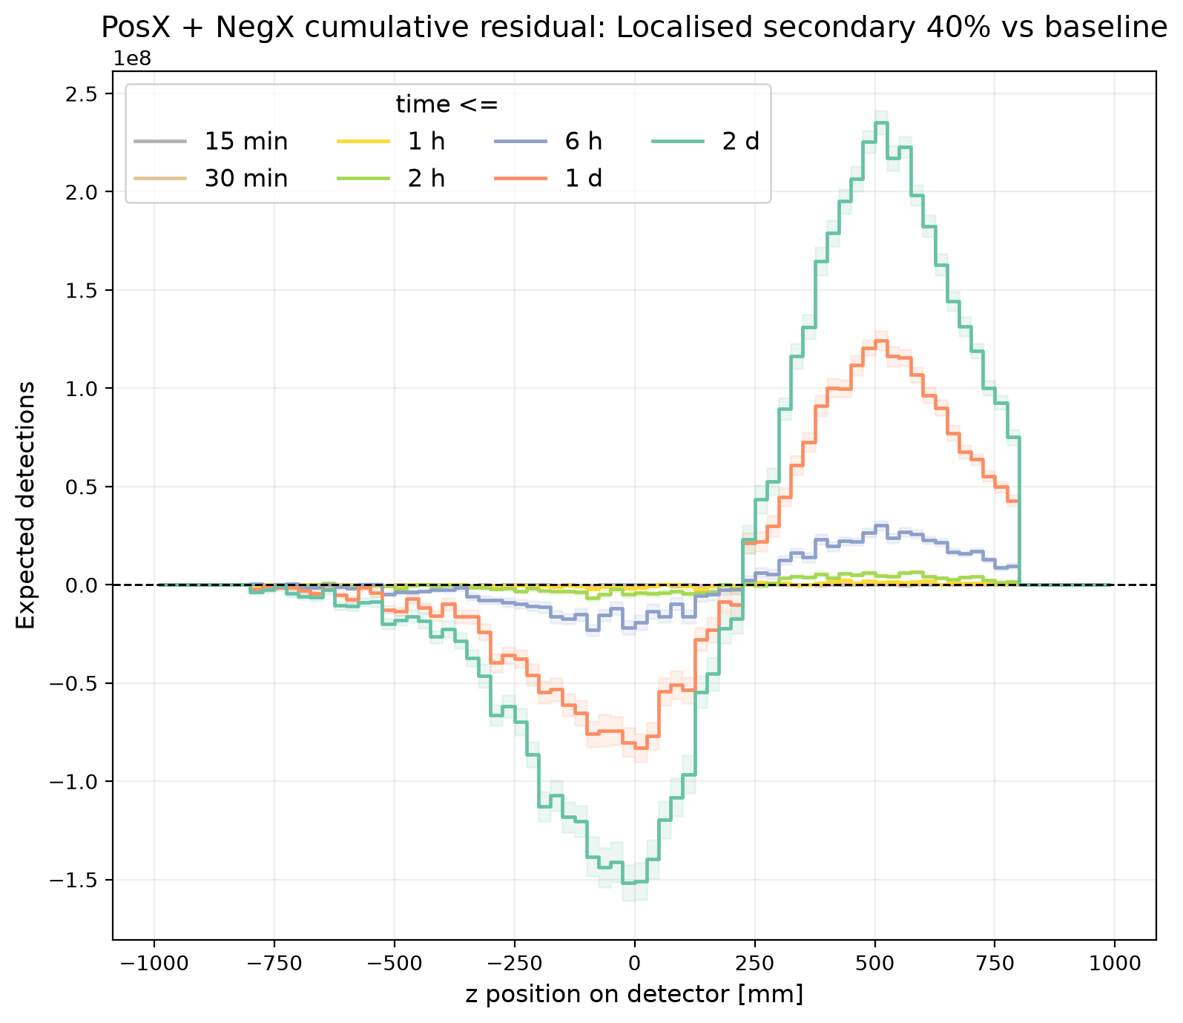
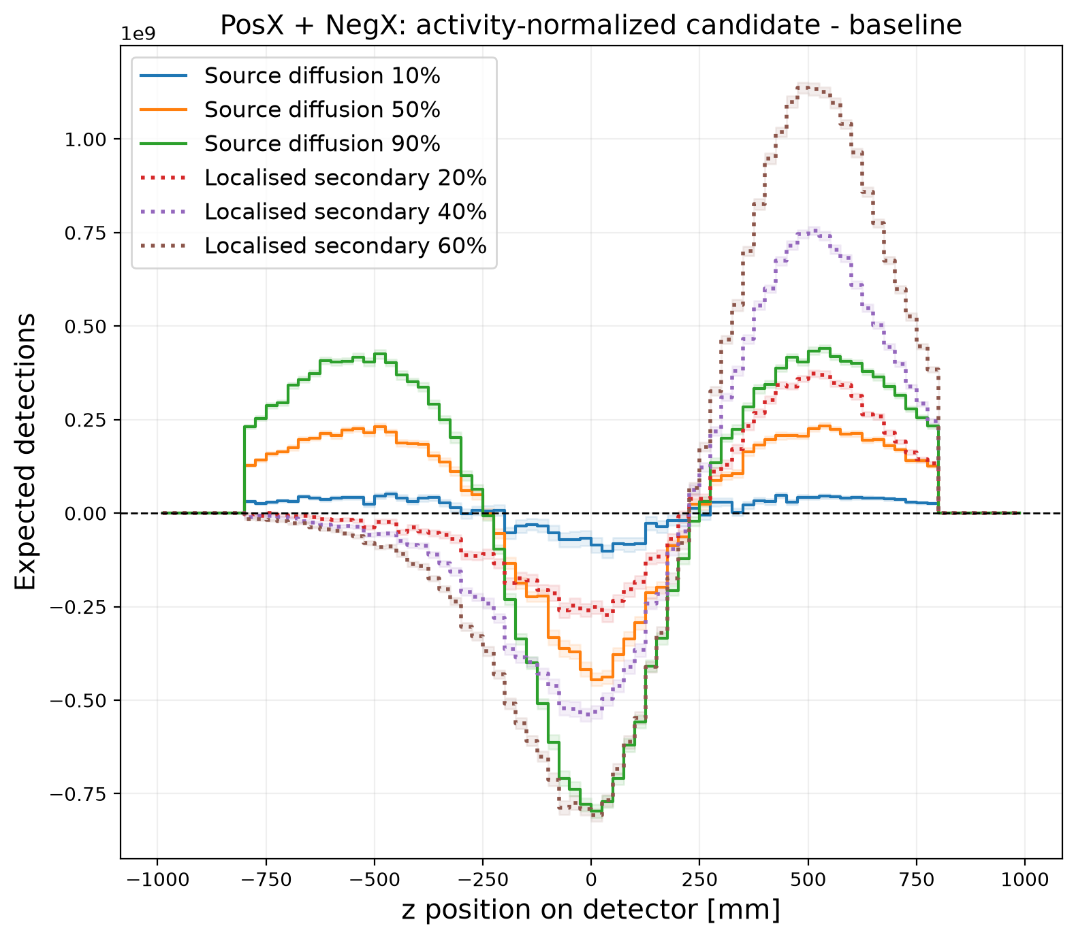
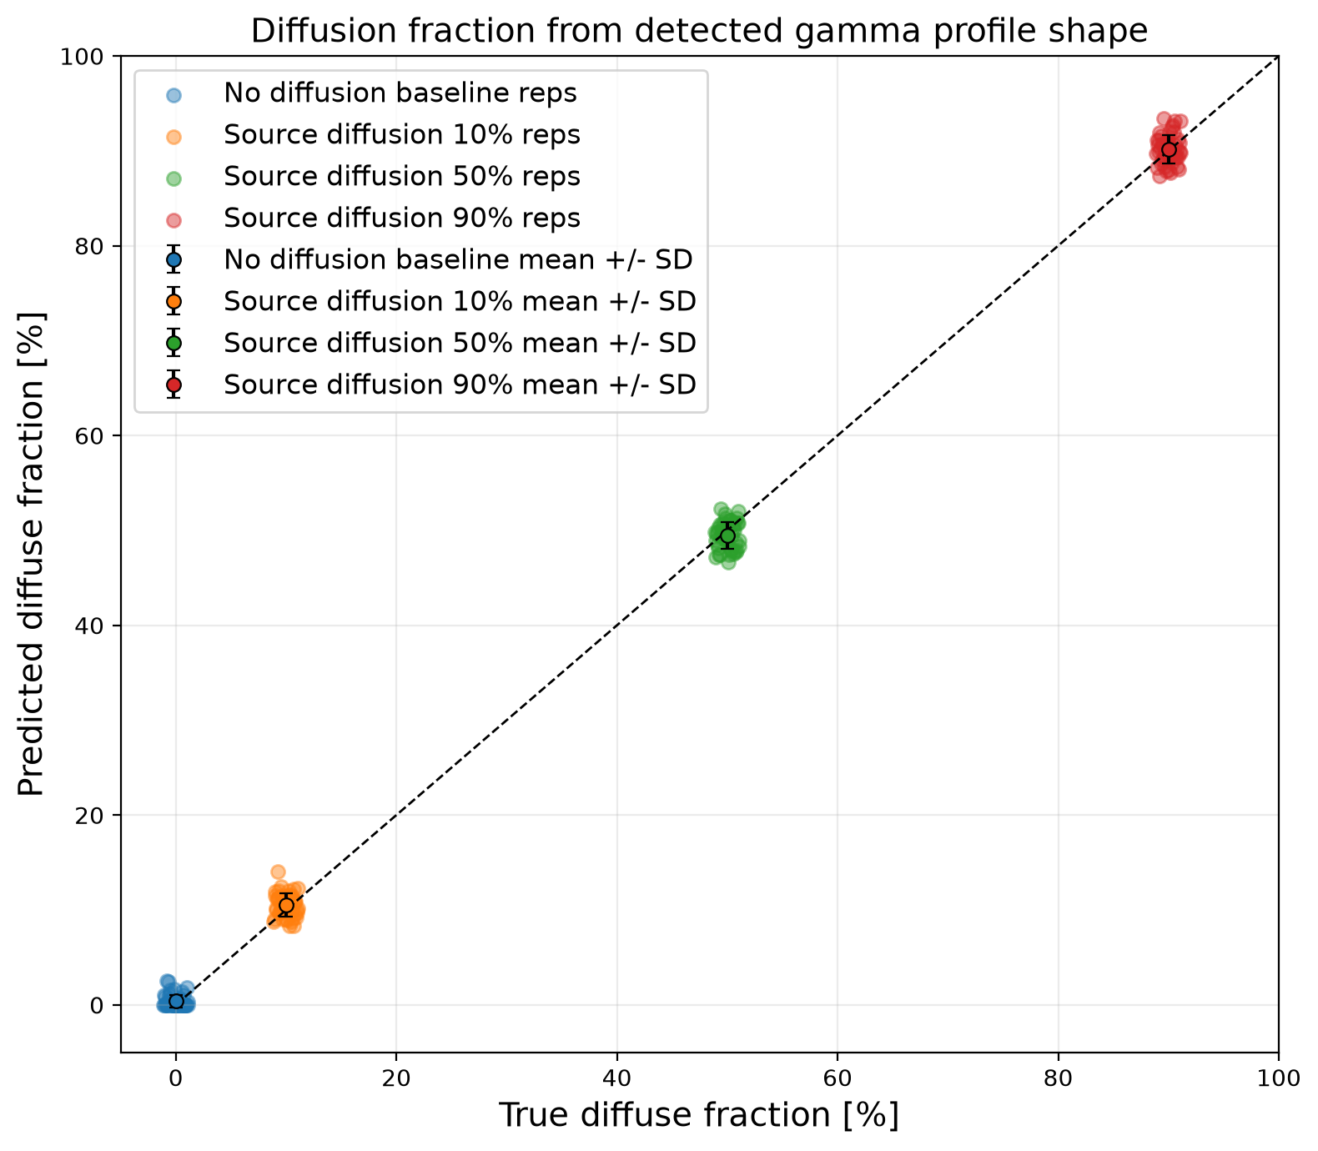
Gamma detection for source localisation in targeted alpha therapy
C. De Sio¹, L. Abu Sabah¹, J. Duan¹, Y. Shi¹, S. Williams¹, J. Velthuis¹
School of Physics, University of Bristol, UK ¹
ABSTRACT
Targeted alpha therapies deliver highly localised dose, but treatment success depends on where the radionuclide source remains after administration. We simulated an AlphaGlue-like geometry [1] using Geant4 [2], with a thin radioactive glue layer on a water phantom surrounded by six photon-detector panels. Retained, broadly diffused, and locally displaced source states were compared using 50 repetitions of 10,000 primary decays per configuration. Baseline-subtracted gamma-hit profiles distinguished retained, diffused, and localised source distributions. Diffusion fraction was reconstructed from residual profile features with R² = 0.9987 and mean absolute error of about 1 percentage point, while localised-source residuals identified displaced activity with mean position errors of 16-30 mm across the tested localised fractions.
1. Introduction
ROI leakage signal and localised-source residuals
AlphaGlue delivery places alpha-emitting material on a tumour region in a thin glue layer. After administration, activity may remain at the intended site, diffuse into surrounding tissue, or redistribute through biological transport. This work tests whether decay-chain gamma emissions can provide a spatial monitoring signal.
A displaced-region ROI was used to test for signal outside the expected retained-source region (top left). Positive excess relative to baseline indicates activity away from the glue due to source broad diffusion; negative signal (relative to baseline) is linked to localised accumulation in a displaced area (top right).
For localised cases, positive residual in the secondary-source ROI estimated source position. Residuals are relative to the true z = 500 mm source (bottom); mean reconstructed positions were 516, 528, and 530 mm for 20%, 40%, and 60%, with uncertainty decreasing at higher fractions.
2. Materials & Methods
A Geant4 [2] model simulated a water phantom with a thin AlphaGlue [1] source on the surface and six surrounding photon-detector panels. Each configuration used 50 independent repetitions of 10,000 primary decays, giving 500,000 decays per configuration and 3.5 million decays across all seven source states. Gamma entries into detector panels were recorded as hits and binned by panel and z position.
Source states tested retained glue activity, 10/50/90% broad diffusion into the phantom, and 20/40/60% localised displacement to a compact region. The retained-source case defined the baseline for spatial comparisons.
CASE | SOURCE STATE
Baseline | 100% retained in glue
Diff10/ 50 / 90 | 10 / 50 / 90% broadly diffused
Loc20/ 40/ 60 | 20 / 40 / 60% localised displacement
Time-window detectability
Hits were accumulated in increasing windows and baseline-subtracted. Detectability required candidate-baseline separation >3σ of the run-to-run baseline variation. In the 50-repetition analysis, 50-90% broad diffusion and 20-60% localised cases crossed threshold in 1-2 hours; 10% broad diffusion required about 6 hours.
3. Results
Baseline-subtracted profiles and diffusion estimate
Detector-position profiles were baseline-subtracted against the retained source to isolate redistribution signal. Broad diffusion widened the residual pattern; localised displacement produced a shifted excess near the displaced source (left). A regression trained on simulated diffuse cases used residual-shape features to estimate diffusion fraction, achieving R² = 0.9987 and mean absolute error about 1 percentage point (right).
4. Discussion
The total detector-entry rate changed by only about 3.8% between retained baseline and 90% broad diffusion. This small global change suggests that total counts alone are insufficient for source localisation. In contrast, baseline-subtracted spatial profiles carried stronger information: broad diffusion changed the residual shape, while localised displacement produced a position-dependent excess. Future work should include detector response, background, dead time, and patient-scale geometries.
References
[1] L. Abu Sabah et al., “AlphaGlue: A Novel Conceptual Delivery Method for α Therapy,” BioMedInformatics 5, 58, 2025.
[2] S. Agostinelli et al., “Geant4—a simulation toolkit,” Nucl. Instrum. Methods Phys. Res. A 506, 250–303, 2003.
[3] L. Ballisat et al., “Geant4 simulation of the enhanced in-vivo 220 Rn spread in DaRT,” Phys. Med. 135, 105005, 2025.
[4] G. Heger et al., “First measurements of radon-220 diﬀusion in mice tumors,” Med. Phys. 51, 5045–5058, 2024.
[5] L. Arazi et al., “The treatment of solid tumors by alpha emitters released from 224 Ra-loaded sources,” Phys. Med. Biol. 55, 1203, 2010.
[6] S. Incerti et al., “The Geant4-DNA project,” Int. J. Model. Simul. Sci. Comput. 1, 157–178, 2010.
CONCLUSION
Baseline-subtracted decay-chain gamma profiles distinguished retained, broadly diffused, and locally displaced AlphaGlue activity. Diffusion fraction was estimated with R² = 0.9987 and about 1 percentage-point mean absolute error, while localised-source residuals identified displaced activity with mean position errors of 16-30 mm. This supports gamma-based post-treatment monitoring as a route to assess source retention and redistribution after targeted alpha therapy.
AOCMP 2026, Pusan, Korea

